Slide 1
Child Development 11 Dr. Smith
CH. 1: Child in Context of Family and Community

Slide 2
Learning Outcomes
In this chapter you will learn to….
Explain how to look at context through the lens of ecological theory
Describe the implications of family-centered approaches, including the benefits to children, teachers, and parents
Explain the history if family-centered care and education
Identify other lenses through which to look at family-centered approaches, including family systems theory and whole child perspective.
Describe Abraham Maslow’s hierarchy of needs

Slide 3
Looking at context through Ecological Theory
We are all immigrants except for the people who were on this continent first, those who can be considered indigenous. Their descendants are still here. The rest of the population is made up of immigrants, whether willing or unwilling (Ogbu, 1987).
Your client is not the child, but the family.

Slide 4
Bronfenbrenner’s Ecological Model

Slide 5
Bronfenbrenner’s Ecological Model
The point of the ecological model is that each component interacts with other components, creating a highly complex context in which the child grows up.
Another point is that the child isn’t just a passive recipient of what goes on in his or her life
As people affect the child, so the child has an influence on them. Nothing remains static.
See the link below for a video on this theory
https://youtu.be/A8b_cnWP1AA
https://youtu.be/k4jLGxz1NhE

Slide 6
Family-Centered Approaches
Family-Centered Approaches
Part of the reason for this movement is increasing regard for the greater context the family is in, which includes culture, race, ethnicity, and economics, among others all of which influence the family’s physical and social location in the neighborhood, community, and greater society.

Slide 7
Family-Centered
Family-Centered Defined
A family-centered approach takes the individual child and the group of children out of the spotlight and instead focuses on the children within their families.
Families along with their children are the program
Family-centered programs offer a variety of services, services in tune with what the parents as individuals and as a group need and want.
Collaboration is a key word.
The point is for professionals to become allies with families and share power.
Through building relationships and ongoing communication the partnership results in mutual learning

Slide 8
The Benefits of Family-Centered Programs for Children
The Benefits of Family-Centered Programs for Children
Understanding the parenting style and complementing it.
Continuity between home and program can be another benefit as teachers and parents understand each other better.
Children’s identity formation is enhanced when children don’t have to experience uncomfortable feelings around the differences between what they learn at school and what they learn at home.
Adults model positive relationships and as a result they can see how respect looks and how it sounds.
Adults should deal with their own biases and increase their ability to communicate across differences, children will watch equity in action

Slide 9
The Benefits of Family-Centered Education Programs for Teachers
The Benefits of Family-Centered Education Programs for Teachers
Teachers and early educators who understand the child within his or her family context can do a better job of supporting development and teaching that child as well as working with the group of children.
It makes the nob more satisfying as teachers watch children gain trust and self-confidence.
Learning about cultures but not in a superficial manner; it’s getting to gain insights about their on child development, education, desired outcomes, and approaches related to their views.
Families add richness to a program and provide resources to professionals.

Slide 10
The Benefits of Family-Centered Education Programs for Families
The Benefits of Family-Centered Education Programs for Families
When families are not part of their children’s education, they have to just hope that what the program provides for their children is the same as what they want.
It makes sense that the goals of the program match the goals of the families or at least don’t contradict them.

Slide 11
Mutual Benefits
Mutual Benefits
One benefit for both teachers and parents is that of self-knowledge about their own culture-the beliefs and values that come from their roots and group membership.
Families including their children and professionals gain from the collaborative relationship in several other ways including:
Enhanced communication as the groups relate to each other around shared power and decision making.
Supportive relationships leading to networks of mutual support.

Slide 12
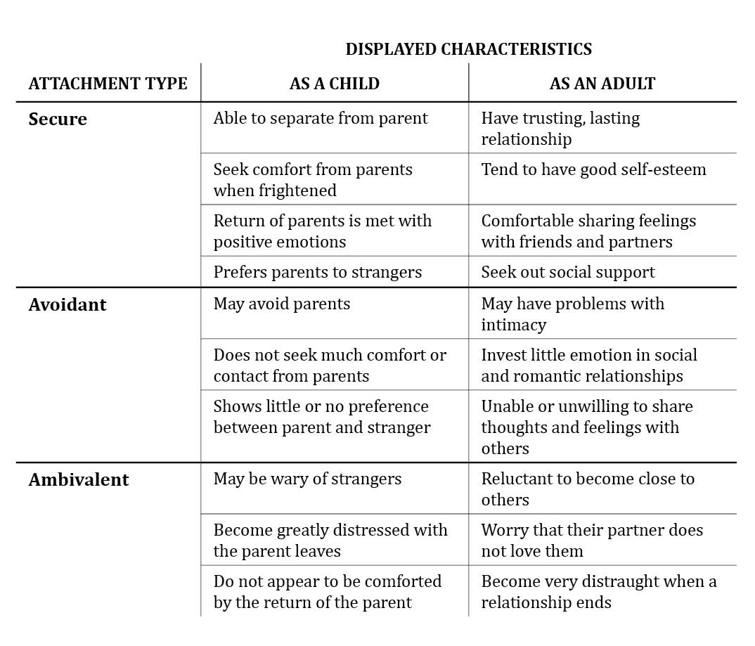
HISTORICAL OF FAMILY-CENTERED CARE AND EDUCATION
John Bowlby a researcher noted for his attachment theory and the harm resulting in separating children in hospitals from their parents.

Slide 13
HISTORICAL OF FAMILY-CENTERED CARE AND EDUCATION (cont.)
Head Start began in Mississippi Freedom Schools and during the War on Poverty of the mid 1960s it became a federally funded comprehensive preschool and social services program with not only a mandate for parent involvement and education but also built-in devices for parents to have some say in the education of their young children in the preschool years.
Bronfenbrenner was co-founder if Head Start and his ecological model had a big influence on creating family-centered programs.
You can click on the link below to see Bowlby’s Theory
https://youtu.be/kwxjfuPlArY

Slide 14
HISTORICAL OF FAMILY-CENTERED CARE AND EDUCATION (cont.)
Ira Gordon created a program that involved parents of infants with goal of improving child outcomes.
He studied parent education and involvement and eventually came up with a hierarchy of types of involvement, moving from parents being recipients of information, to learning new skills, to teaching their own children and becoming classroom volunteers.
The special education law PL 94-142 called the Disabilities Education Act (IDEA) mandated parent involvement in planning for the education of the child.
Each child identified with a disability or special need must have an Individual Educational Plan (IEP) or if an infant or toddler and Individualized Family Service Plan (IFSP).

Slide 15
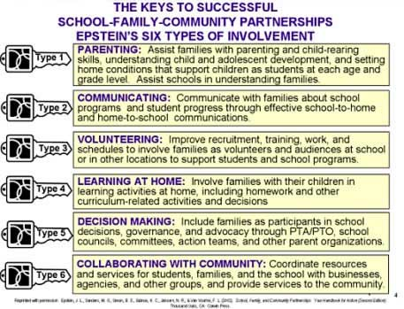
HISTORICAL OF FAMILY-CENTERED CARE AND EDUCATION (cont.)
The Epstein Model, based on Gordon’s roles for parent involvement, was created by Joyce Epstein. The handbook lists the 6 types of partnerships that reflect Gordon’s hierarchy using a little different language and going one step further

Slide 16
HISTORICAL OF FAMILY-CENTERED CARE AND EDUCATION (cont.)
As parent move up the “involvement ladder” they move beyond thinking about their own children and become an advocate for all children. (talk about the Mendez trial)
One of the premises of all these family-centered early care and education programs s that they work better when professionals understand families and involve them in respectful ways.

Slide 17
Challenges to Creating Partnerships with Families
Challenges to Creating Partnerships with Families
Responsive when you think you know more than the family does but families also have funds of knowledge that professionals don’t have. It’s the professionals’ job to acknowledge that fact and to learn from parents as well as teach them.
It requires suspending judgments when the professional thinks families are wrong or misguided, even if research backs up the professional.
The link below is how a teacher can create partnerships with students and families
https://www.ted.com/talks/rita_pierson_every_kid_needs_a_champion?language=en

Slide 18
The Family Systems Theory Lens
The Family Systems Theory Lens
The theory behind family systems theory is that families may be very different but they all have some things in common and that is that they are governed by systems.
One system is communication and another is rules
Families are connected to each other; each one influences the others and all are influenced by the family system.
Educators aren’t therapists and shouldn’t be doing therapy but you can find the resources that can help them and do a referral.
A danger of using the family systems theory is the temptation to play therapist. Another danger is judging other people’s family systems without regard to your own.

Slide 19
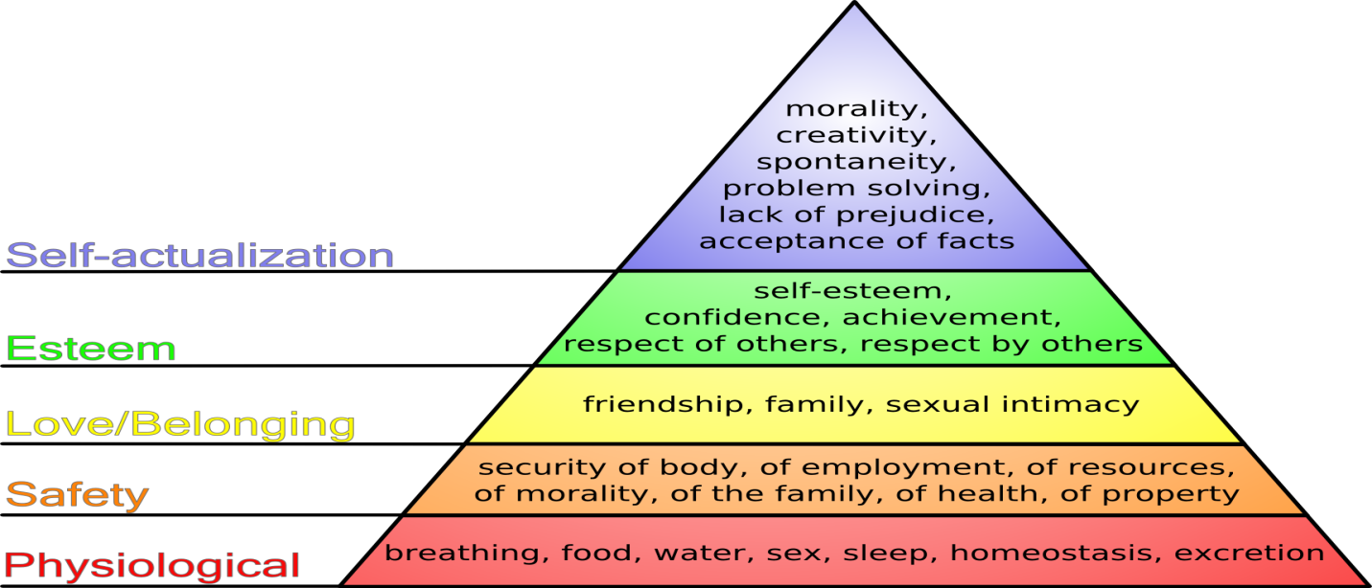
The Whole Child Lens
The Whole Child Lens
The child is made of mind, body, feelings and one system is vitally tied into the others.
MASLOW’S HIERARCHY OF NEEDS

Slide 20
The Whole Child Lens (cont.)
The link below is on Maslow’s theory in action
https://youtu.be/tzQ9vrvTAtk
The idea is to take a collaborative approach
Collaborative approach means that change not only occurs within the families, but also within the program as it begins to reflect those enrolled rather than just predetermined policies and practices.
Empowering parents through making programs more collaborative.

Slide 21
The Whole Child Lens (cont.)
To teach advocacy is giving a voice. Giving people the tools, skills, and support needed to make their voices heard in support of their vision.
Advocacy helps ordinary people become involved in public life.
It helps them gain support for their rights as they become empowered and confident.

